Slide 1
PREDICTIVE MODELING FOR SMARTPHONE PURCHASE BEHAVIOR
Project Presentation
By: MANDAR SANJAY KAJBAJE

Slide 2
Introduction
Smartphone companies struggle to identify which customers are likely to make purchases, leading to inefficient marketing spending and missed opportunities
Develop an AI-powered prediction system using machine learning to analyze customer demographics, behavior patterns, and preferences
Enable data-driven marketing decisions, improve customer targeting accuracy, and provide real-time insights through an interactive web dashboard

Slide 3
Objectives
Build a machine learning model to predict whether a customer will purchase a smartphone based on demographics and behavior
Create a user-friendly web dashboard for real-time predictions and data visualization
Provide actionable insights for marketing teams to target high-probability customers

Slide 4
Methodology: Data & Preprocessing
Dataset Size: 10,000+ records with 18 features including age, income, brand preference, and usage patterns
Data Cleaning: Handle missing values, outlier detection, and standardize column formats for consistent processing
Feature Engineering: Create derived features, one-hot encode categorical variables (brands), and apply StandardScaler normalization

Slide 5
Methodology: Model & Dashboard
Algorithm Choice: Random Forest Classifier for high accuracy and feature importance interpretation
Model Pipeline: Preprocessing → Feature scaling → Model training → Validation with 10-fold cross-validation
Dashboard Architecture: Flask REST API backend with HTML/CSS/JS frontend using Chart.js for interactive visualizations

Slide 6
Accuracy Comparison Across Models
Random Forest: 87.3% accuracy (chosen model) - Best balance of accuracy and interpretability
Logistic Regression: 82.1% accuracy - Good baseline but lower performance on complex patterns
XGBoost: 86.8% accuracy - Strong performance but less interpretable than Random Forest

Slide 7
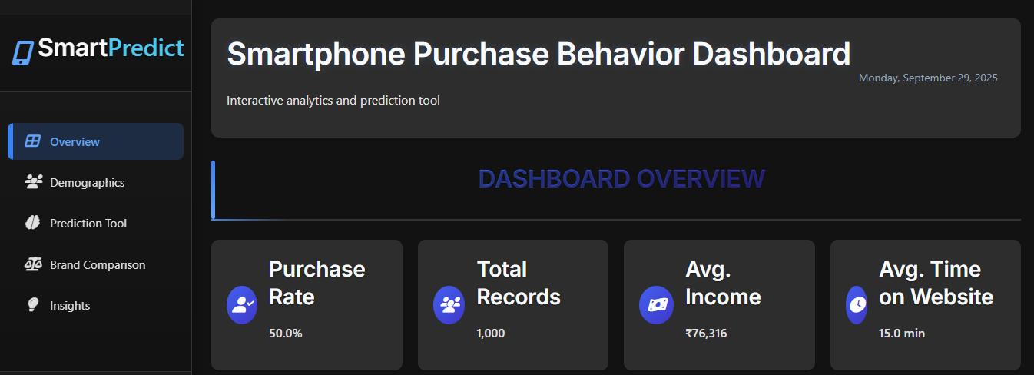
Results

Slide 8
Conclusion
High Accuracy: Achieved 87.3% prediction accuracy with excellent precision (85.1%) and recall (89.7%)
Practical Application: Successfully deployed interactive dashboard with real-time predictions and brand comparison
Business Value: Identified key factors (age, income, brand loyalty) that drive smartphone purchases for targeted marketing

Slide 9
Future Enhancements
Advanced ML: Implement deep learning models and ensemble methods to potentially increase accuracy beyond 90%
Real-time Data: Integrate live market data feeds and social media sentiment analysis for dynamic predictions
Mobile App: Develop native mobile application with offline prediction capabilities and enhanced user experience

Slide 10
THANK YOU

